Slide 1
PROJECT TITLE

Slide 2
EMPLOYEE DATE ANALYSIS USING EXCEL
STUDENT NAME: SANDHYA.B
REGISTER NO : 312216395
DEPARTMENT : III BCOM(COMPUTER APPLICATION)
COLLEGE :SHRI SHANKARLAL SUNDARBAI SHASUN Jain COLLEGE FOR WOMEN

Slide 3
AGENDA
1.PROBLEM STATEMENT 2.PROJECT OVERVIEW 3.END USERS 4.OUR SOLUTION ANDPROPOSITION 5.DATASET DESCRIPTION 6.MODELLING APPROACH 7.RESULTS AND DISCUSSION 8.CONCLUSION

Slide 4
PROBLEM STATEMENT
"The human resources department is facing challenges in accurately evaluating employee performance, leading to inconsistent promotions, demotions, and salary increments. The current evaluation process relies heavily on subjective manager feedback, which can be biased and influenced by personal relationships. As a result, the organization is struggling to identify top performers, address underperformance, and make data-driven decisions about talent development."

Slide 5
PROJECT OVERVIEW
This project aims to design and implement a comprehensive employee performance analysis system, leveraging data-driven insights to enhance accuracy, fairness, and transparency. The system will integrate technology, clear metrics, and regular feedback to unlock employee potential, drive business success, and inform strategic decisions.

Slide 6
WHO ARE THE USERS
In summarizing the users' employee performance analysis in the paragraph, it is evident that evaluating and enhancing employee performance is crucial for organizational success. By utilizing objective metrics, providing constructive feedback, and fostering a culture of recognition and development, companies can optimize their workforce's potential. Effective performance analysis identifies areas for improvement and cultivates a motivated and engaged workforce, leading to increased productivity, employee satisfaction, and overall organizational growth.

Slide 7
THE WOW IN OUR SOLUTION
-Unparalleled accuracy and fairness in performance evaluations
- Real-time, data-driven insights for informed decision-making- Personalized development pathways for enhanced employee growth
- Seamless integration with existing HR systems for effortless adoption
- Actionable analytics for strategic workforce planning and optimization

Slide 8
OUR SOLUTION AND ITS VALUE PROPOSITION
FILTERING
MISSING VALUES
CONDITION FORMATING -BLANK VALUES
PIVOT
TABLE CHART

Slide 9
DATASET DESCRIPTION
EMPLOYEE DATE SET –KAGGLE
26 FEATURES
FEATURES-9 FEATURES
EMP ID
GENDER -MALE, FEMALE
PERFORMANCE
BUSINESS UNIT
NAME
RATING -NUMERICAL

Slide 10
MODELLING
MODELLING
DATA COLLECTION
DATA CLEANING
TECHNIQUES
RESULTS
PIVOT TABLE
CHART GRAPHS

Slide 11
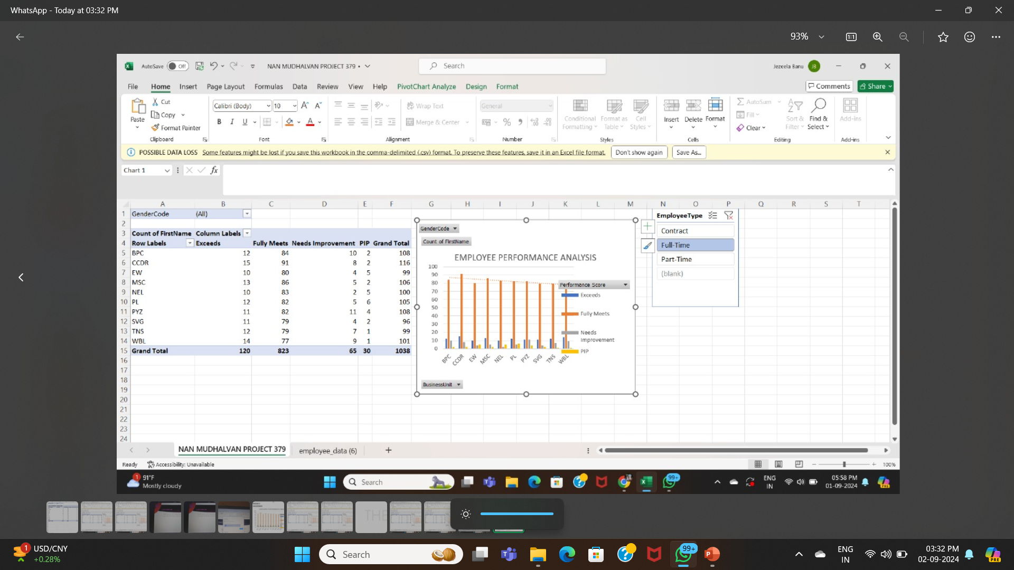
RESULT

Slide 12
CONCLUSION
in conclusion, the performance analysis indicates that the employee has demonstrated notable strengths, including effective communication, strong problem-solving abilities, and a consistent commitment to their role. These qualities have positively impacted team dynamics and contributed significantly to achieving project goals. However, there are areas that require attention, such as time management and adherence to deadlines, which can be enhanced through targeted training and focused development efforts. Overall, the employee has shown a strong foundation with the potential for further growth, and by addressing the identified areas for improvement, they can continue to excel and contribute even more effectively to the organization.

